Slide 1
Project title: Smart Coffee cooperative management system.
Course Code & Name: DPR400210 - Database Programming.
Student Details: Name: Constance B Nimley /Reg#:26332/2024]
University of Lay Adventists of Kigali (UNILAK)
Presentation Date: July 15, 2026

Slide 2
Problem Definition & Context of Use.
In Rwanda, coffee production is a major economic driver. However, agricultural cooperatives face severe challenges in tracking coffee cherry deliveries from smallholder farmers, managing warehouse processing (sorting, drying, washing), monitoring inventory levels, and maintaining transparent payments. Manual record-keeping leads to:
*Data entry errors.
*Delayed payments to farmers.
*Lack of real-time inventory tracking (parchment vs. green coffee).
*Lack of an audit trail to prevent fraud.

Slide 3
Target Users:
Cooperative Farmers: Deliver cherries and receive SMS/receipt confirmations.
Warehouse Managers: Manage inventory, wet mill processing, and shipping.
Financial Officers: Execute and approve farmer payouts.

Slide 4
Project Objectives:
Design a normalized, secure database schema (3NF) to handle members, deliveries, processing stages, and financial payouts.
Enforce critical business rules programmatically using Oracle PL/SQL.
Implement automated triggers for activity auditing and strict temporal operational restrictions.
Provide clear procedures and functions to streamline transactions and reporting.
Security & Compliance: Implement operational window locks (blocking transactions on holidays/weekends) and record a complete audit log of financial adjustments.

Slide 5
Business Process Modeling (MIS):
The physical workflow covers three primary stakeholders:
Farmer: Delivers fresh coffee cherries at the cooperative gate.
Warehouse Clerk: Weights the cherries, assigns quality grades, and registers the batch.
Finance Officer: Approves and processes calculated payments.
The Smart Coffee Cooperative Database System covers the lifecycle of coffee from the physical point of delivery up to the final financial approval. It spans three functional departments within the cooperative

Slide 6
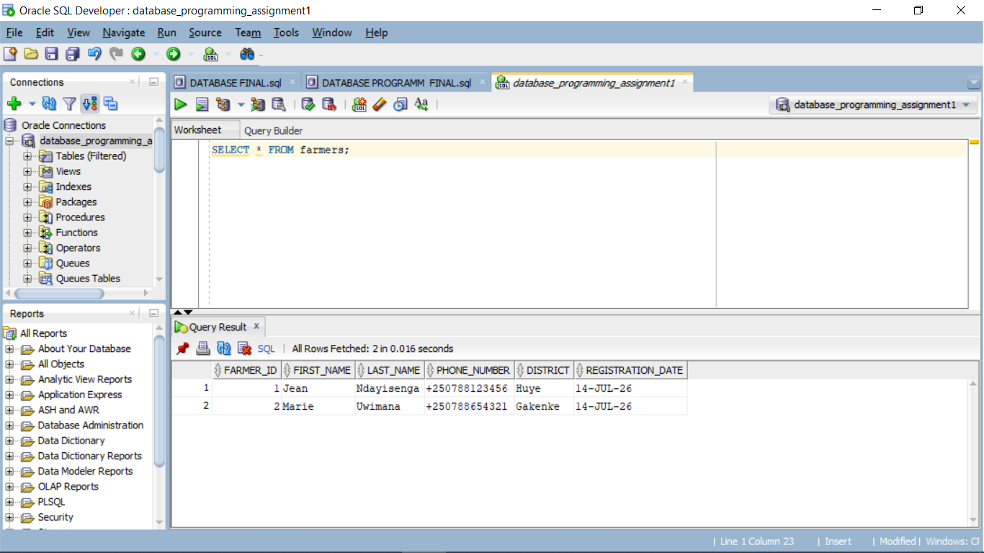
Table creation: FARMER TABLE

Slide 7
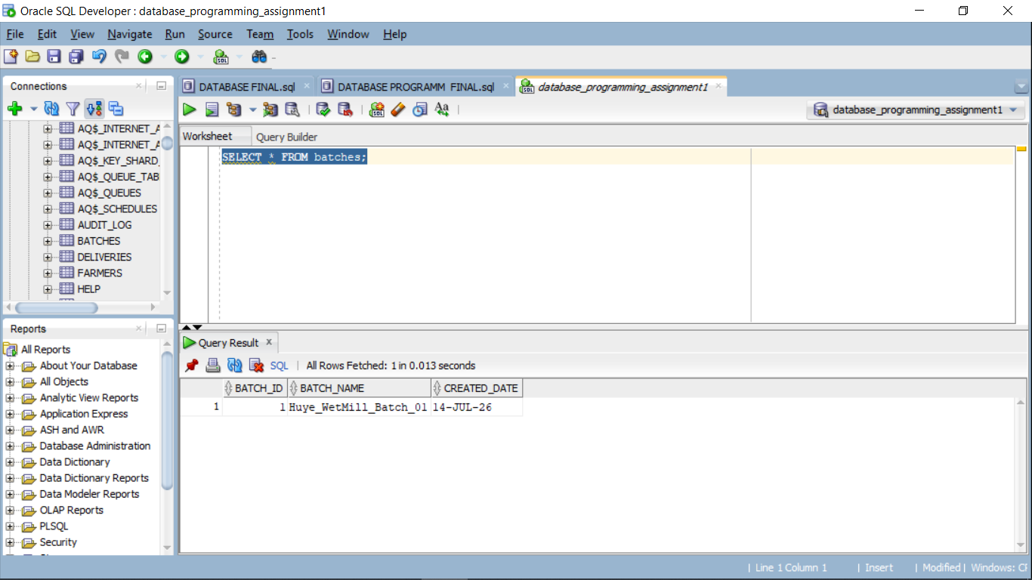
BATCHES TABLE

Slide 8
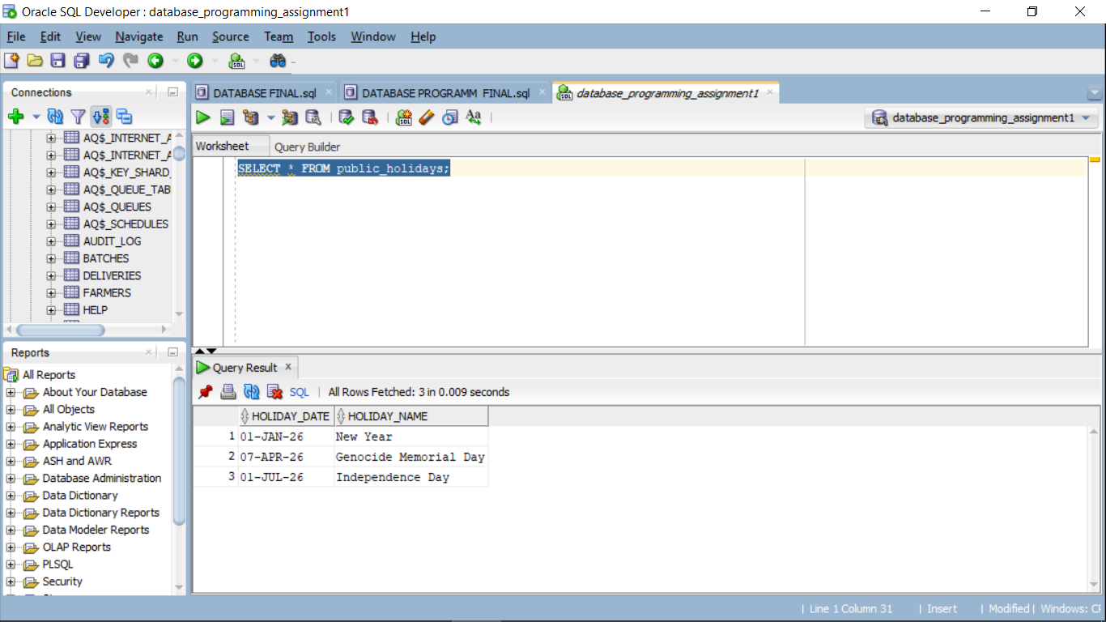
PUBLIC_HOLIDAY TABLE

Slide 9
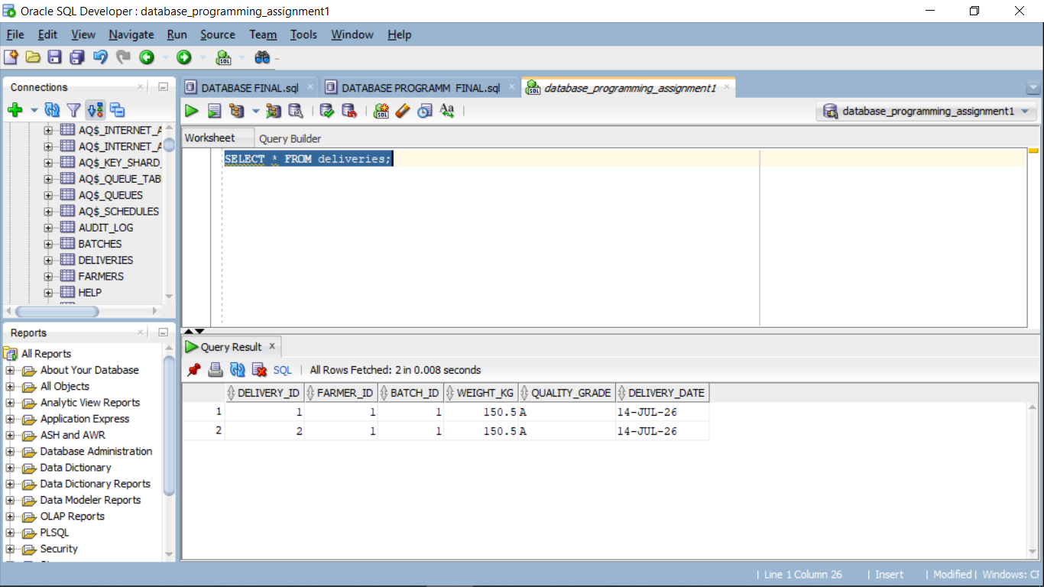
Deliveries table

Slide 10
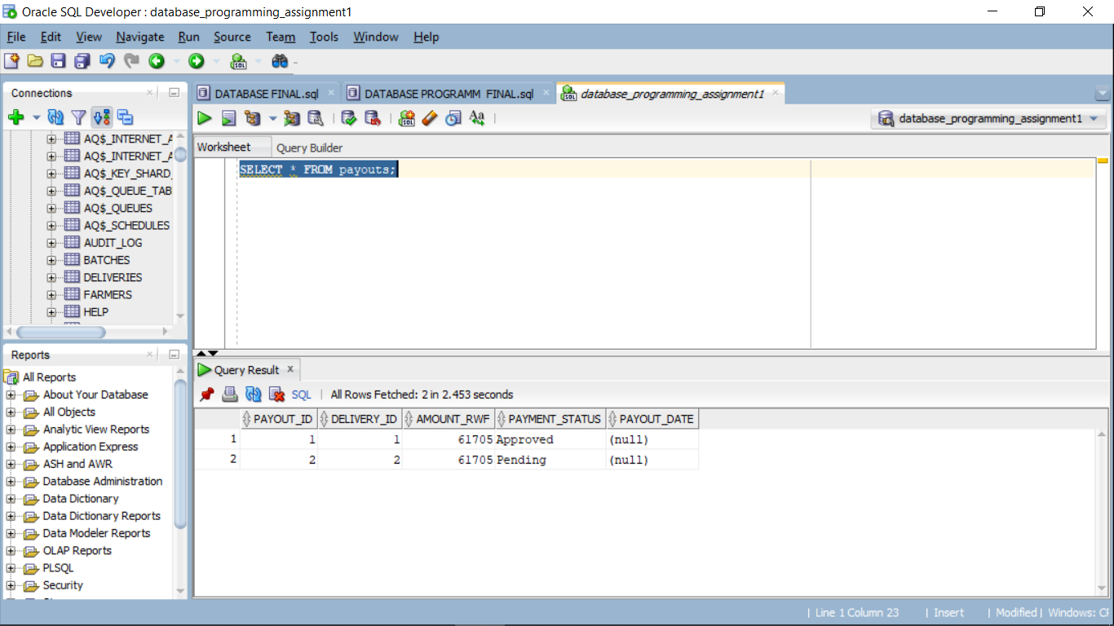
PAYOUTS TABLE

Slide 11
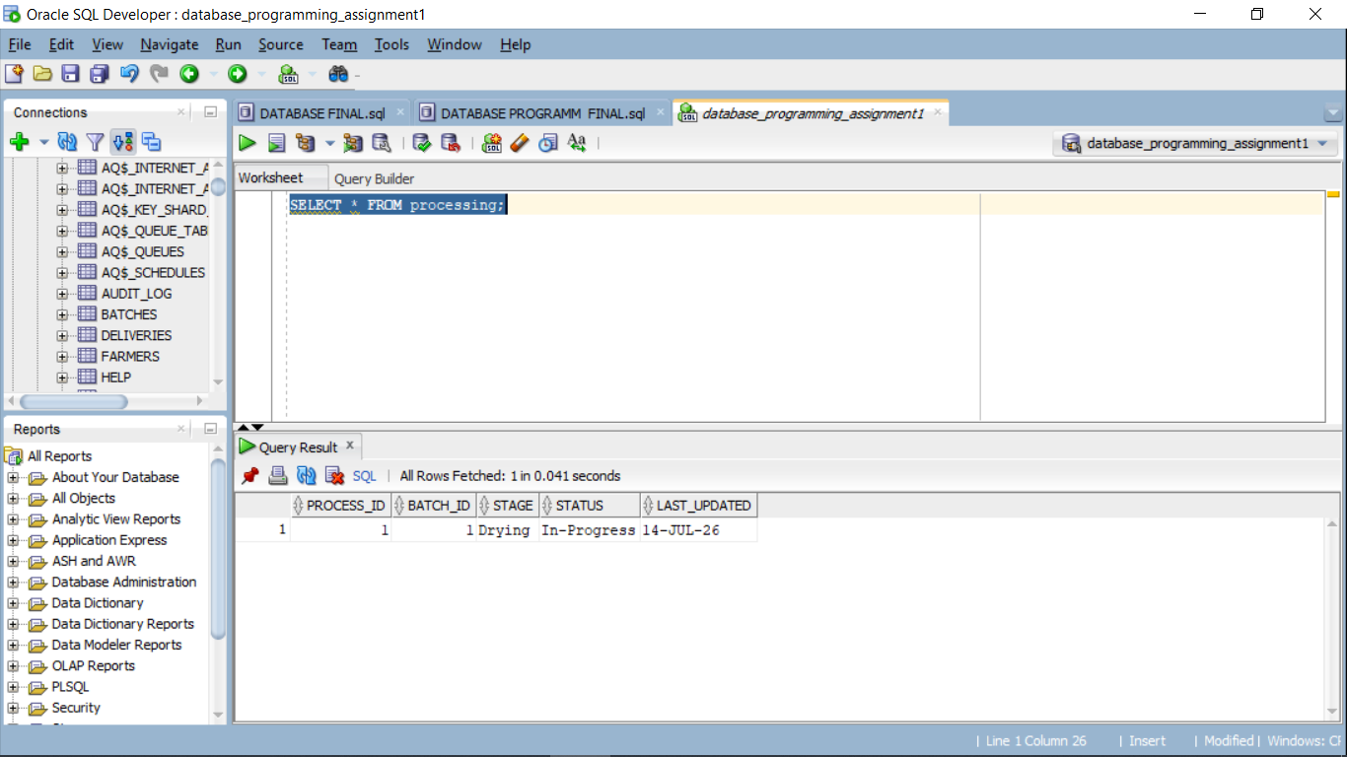
PROCESSING TABLE

Slide 12
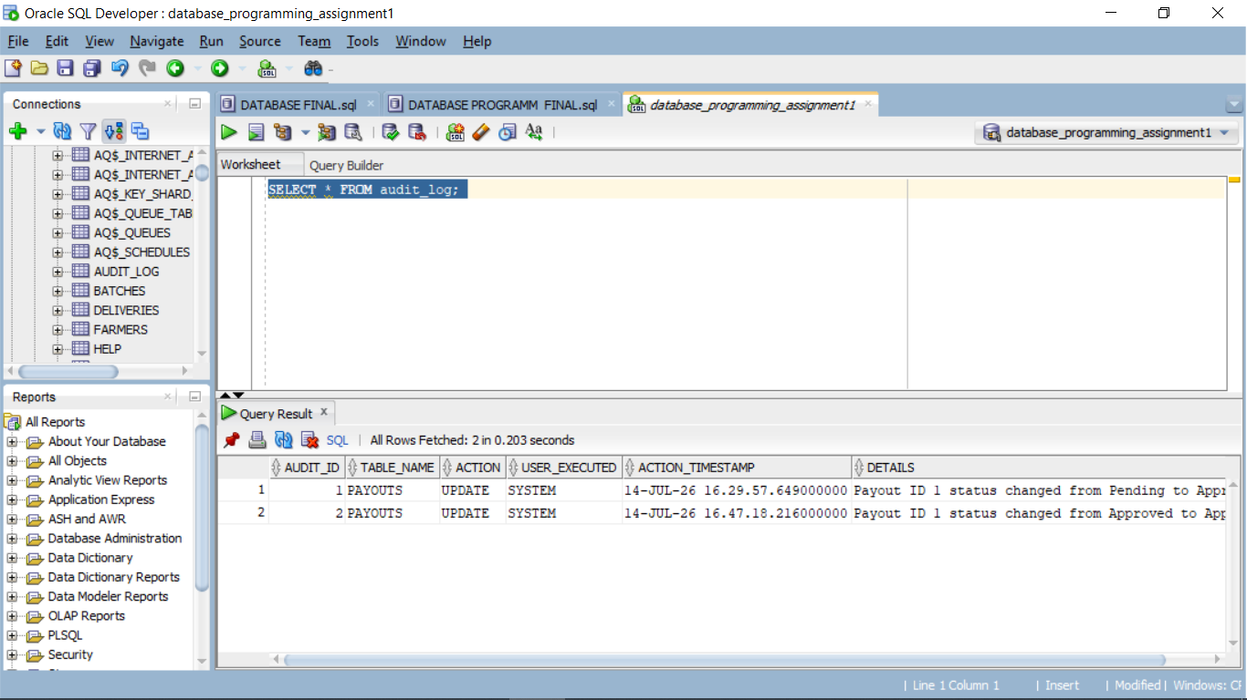
AUDIT_LOG TABLE

Slide 13
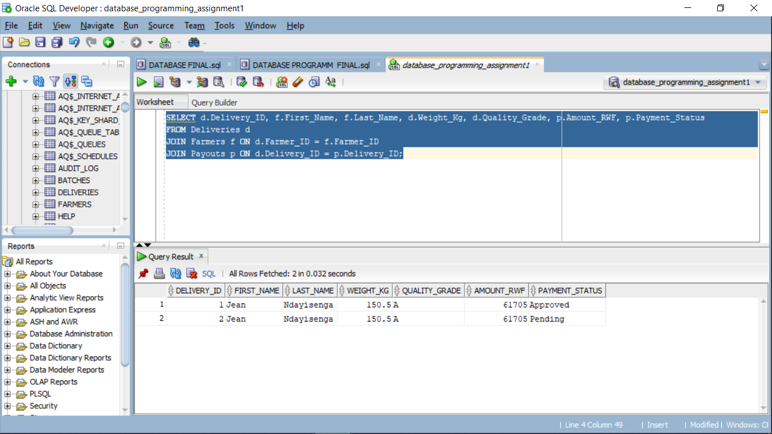
VERIFY both the Deliveries and Payouts tables:

Slide 14
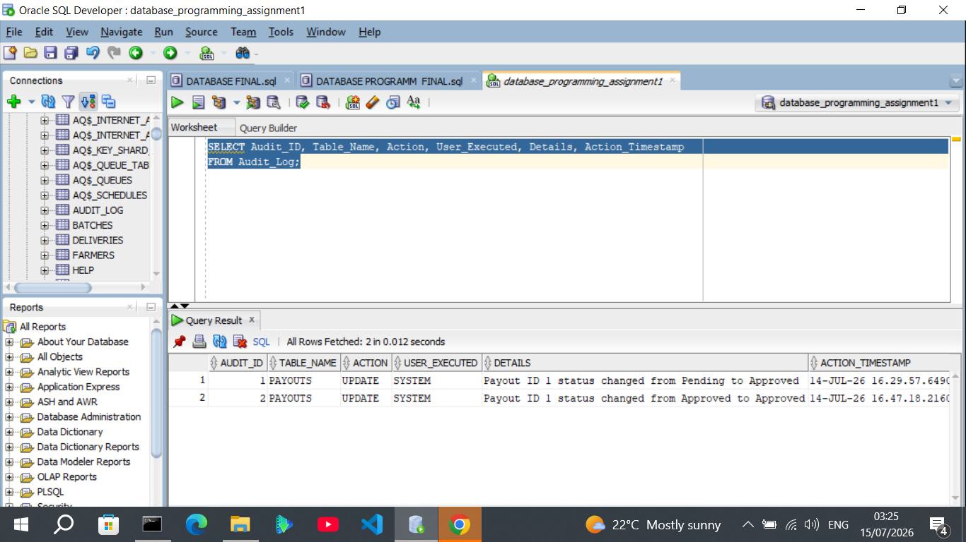
prove that the trigger captured the change automatically:

Slide 15
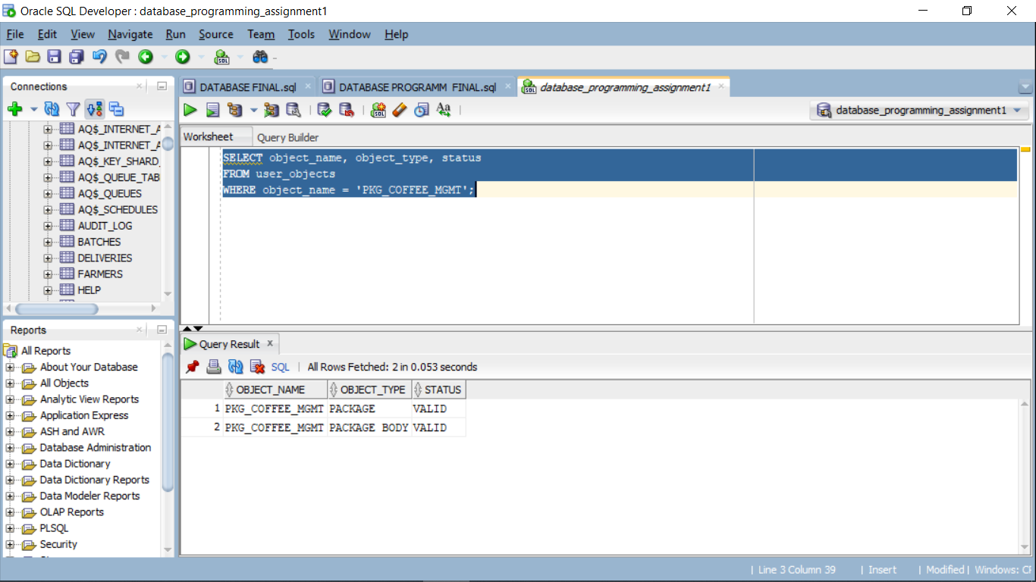
Check package body and package object:

Slide 16
Project Conclusion:
This capstone project showcases the practical application of advanced Oracle SQL and PL/SQL concepts to solve a real-world, high-impact problem. The system is not only technically sound and highly performant but is also built with the security, auditability, and scalability required to support the local coffee farmers and washing stations driving Rwanda's agricultural economy.

